Slide 1
A Presentation on ‘Car Claim Insurance Analysis’

Slide 2
Today’s Agenda
Project Objective
Problem
Process
Insights
Recommendations

Slide 3
Project Objective
The objective of the project is to leverage data analytics to drive business value for the insurance company, improve customer satisfaction, and optimize operational performance across various facets of the insurance business by considering various fields for claimants given in dataset.

Slide 4
Problem
Increase business valuation.
To identify the amount of insurance claimed by claimants.
Type of customers are joined with company.
Are they getting claims according to their need.
Company’s management system is ready to give big claims sometimes or not.

Slide 5
Process
1.
Understanding Problem
2.
Data Extraction
3.
Data Analysis
4.
Data Visualization

Slide 6
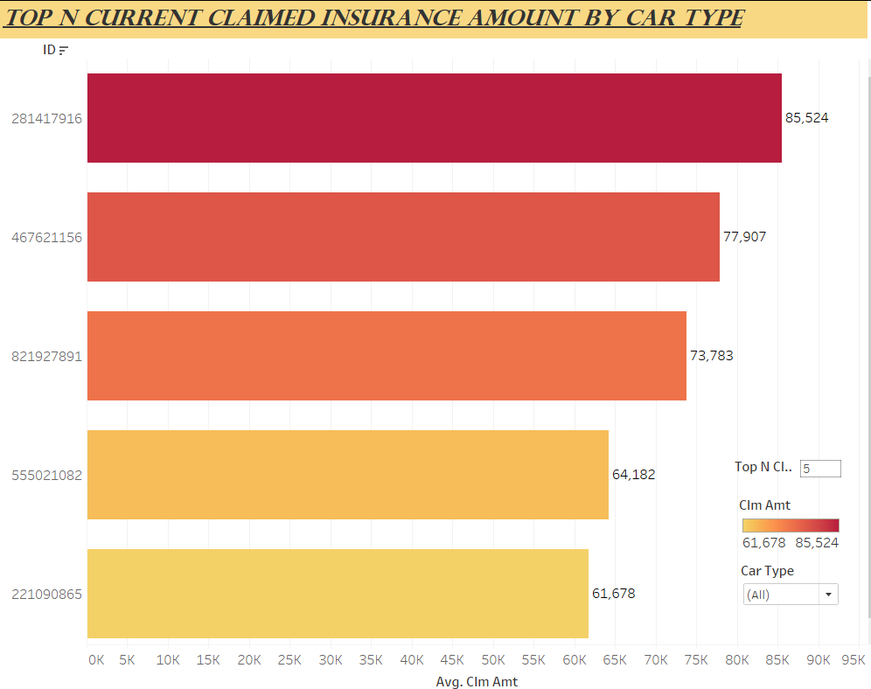
Insights
These are Top 5 Claimants.
85524 $ is the maximum amount claimed by an individual.

Slide 7
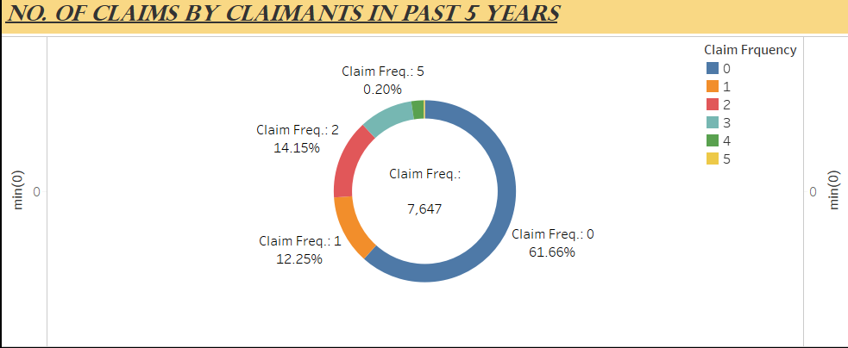
62% approximate claimants didn’t claimed any insurance since 5 years.
Only 0.2% had claimed 5 insurance in past 5 years.

Slide 8
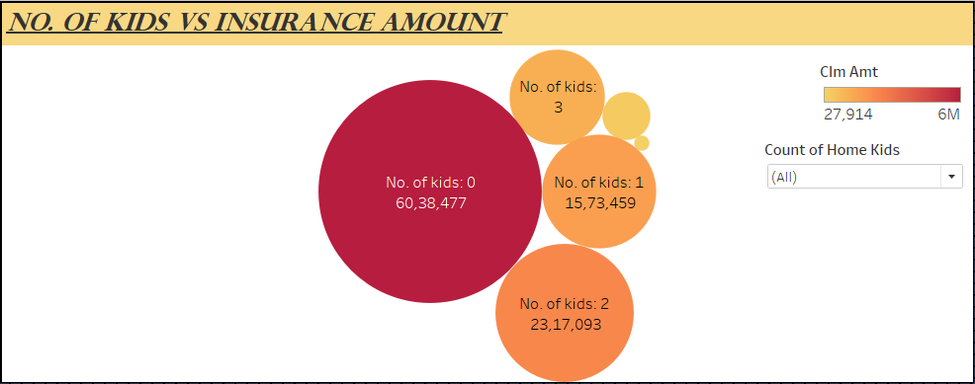
Those who are claiming high amounts are having 0 kids at their home.

Slide 9
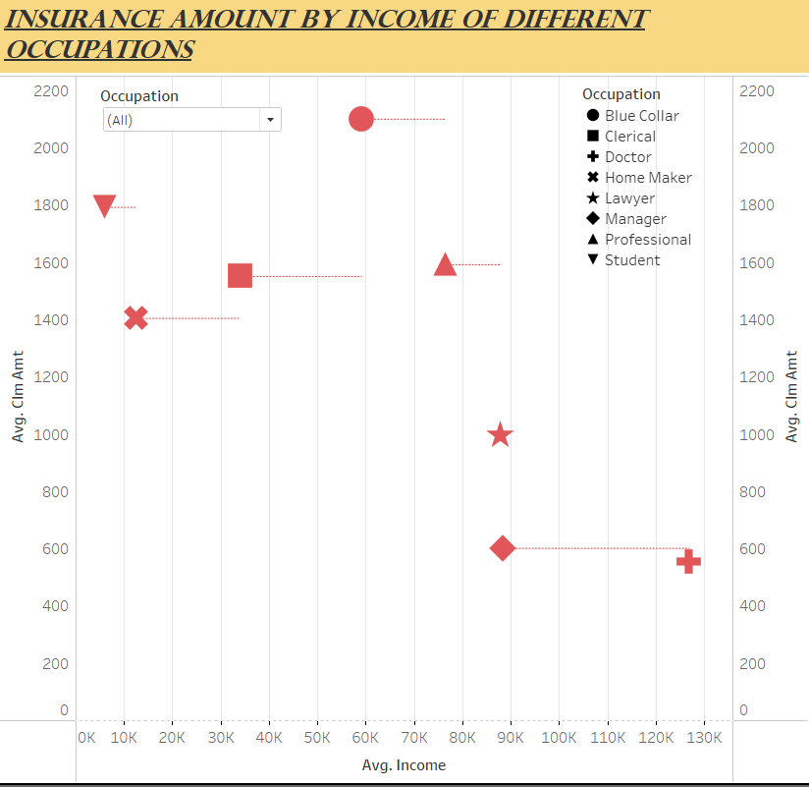
Those who are earning higher income like Doctors, Managers and Lawyers, claimed very less insurance compared to others.

Slide 10
Recommendations
Targeted Marketing
Encourage Regular Insurance
Make Insurance for Single Parents Better
Give Discounts for Safe Drivers
Awareness about Insurance
Be Ready for Big Claims
Create Insurance that Fits People's Lives

Slide 11
Thank You!
Any Question

